Slide 1
Idea del Clustering Jerárquico: Utilizando los Dendrogramas

Slide 2
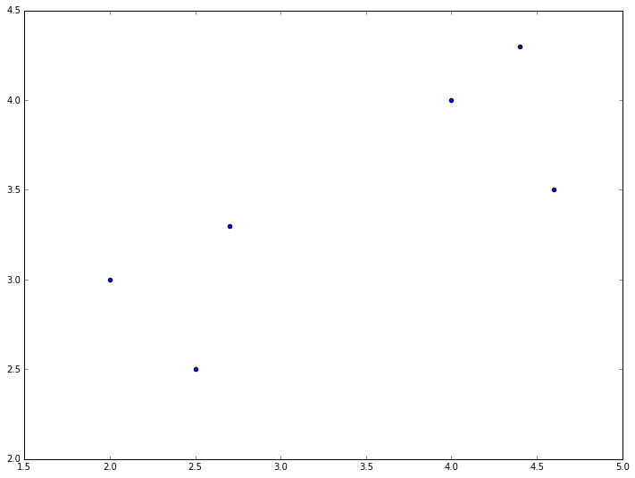
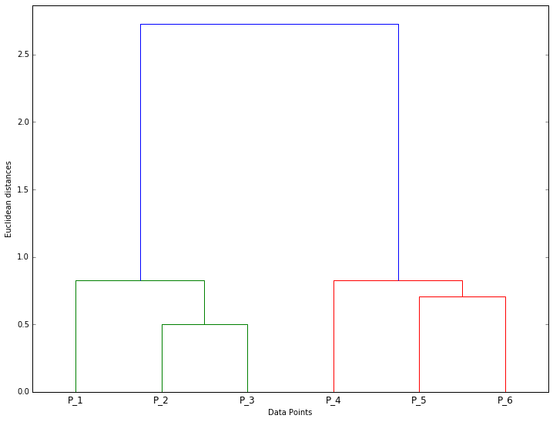
Dendrogramas – Dos Clusters
P3
P2
P1
P4
P5
P6

Slide 3
Dendrogramas – Dos Clusters
P3
P2
P1
2 clusters
P4
P5
P6
Notes:
The horizontal line crosses Dos vertical lines => 2 clusters

Slide 4
Dendrogramas – Cuatro Clusters
P3
P2
P1
P4
P5
4 clusters
P6
Notes:
The horizontal line crosses Cuatro vertical lines => 4 clusters

Slide 5
Dendrogramas – Seis Clusters
P3
P2
P1
P4
P5
P6
6 clusters
Notes:
The horizontal line crosses six vertical lines => 6 clusters

Slide 6
Dendrogramas – Número óptimo de Clusters
P3
P2
2 clusters
P1
Distancia más larga
P4
P5
P6
Notes:
The horizontal line that can make the Distancia más larga without crossing any horizontal line is this one with 2 clusters => Therefore the optimal number of clusters is Dos.

Slide 7
Test de Conocimientos

Slide 8
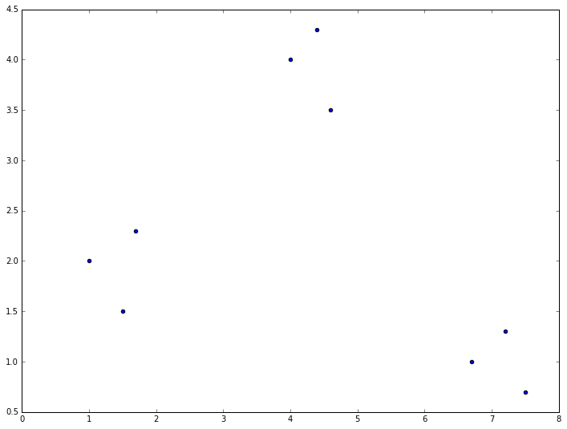
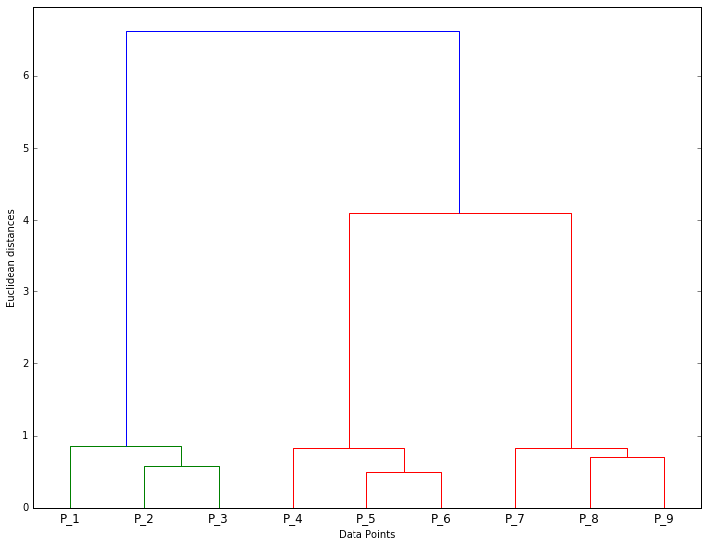
Dendrogramas – Test de Conocimientos
P6
P5
P4
???
???
P7
P8
3 clusters
Distancia más larga
P9
P3
P2
P1
Notes:
The horizontal line that can make the Distancia más larga without crossing any horizontal line is this one with 3 clusters => Therefore the optimal number of clusters is three.

Slide 9
Dendrogramas – Test de Conocimientos
P6
P5
P4
???
P7
P8
P9
P3
P2
P1
Notes:
The horizontal line that can make the Distancia más larga without crossing any horizontal line is this one with 3 clusters => Therefore the optimal number of clusters is three.

Slide 10
Dendrogramas – Test de Conocimientos
P6
P5
P4
???
P7
P8
Distancia más larga
P9
P3
P2
P1
Notes:
The horizontal line that can make the Distancia más larga without crossing any horizontal line is this one with 3 clusters => Therefore the optimal number of clusters is three.

Slide 11
Dendrogramas – Test de Conocimientos
P6
P5
P4
???
P7
P8
3 clusters
Distancia más larga
P9
P3
P2
P1
Notes:
The horizontal line that can make the Distancia más larga without crossing any horizontal line is this one with 3 clusters => Therefore the optimal number of clusters is three.

Slide 12
Dendrogramas – Test de Conocimientos
P6
P5
P4
P7
P8
3 clusters
Distancia más larga
P9
P3
P2
P1
Notes:
The horizontal line that can make the Distancia más larga without crossing any horizontal line is this one with 3 clusters => Therefore the optimal number of clusters is three.

